Slide 1
Effect of living standard on crime rates in Almaty
Ali Nurkuspan
Ruslan Shaltabayev

Slide 2
Pain
Although the income rates and living wages increase, the amount of people below the minimum living wage increases too. It is more observable in families with 5 or more persons. Our study analyzes the effect of the income rate on the crime rate.

Slide 3
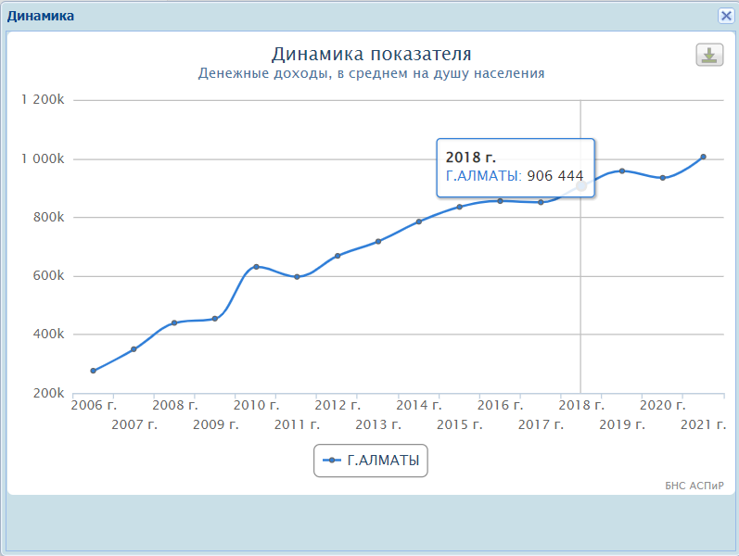

Slide 4
Dataset used:
https://taldau.stat.gov.kz/ru/NewIndex/GetIndex/704767?keyword=
https://taldau.stat.gov.kz/ru/NewIndex/GetIndex/704453?keyword=

Slide 5
Hypothesis
Crime rates in Almaty are higher than any other regions of Kazakhstan.
Low living standards in Almaty affect the crime rate in Almaty.

